Slide 1


Applying Machine Learning Techniques (MLT) into Remote Sensing (RS) Research to support Disease Prediction and Public Health Decision-Making
EMILY ZHOU, MUSA6500-S24
Original Paper: Spatial estimation of chronic respiratory diseases based on machine learning procedures—an approach using remote sensing data and environmental variables in Quito, Ecuador (2020)
Author: Alvarez-Mendoza, C. I., Teodoro, A., Freitas, A., & Fonseca, J.
Publication: https://doi.org/10.1016/j.apgeog.2020.102273
Keywords: spatial modeling, respiratory disease, machine learning, remote sensing, quito

Slide 2
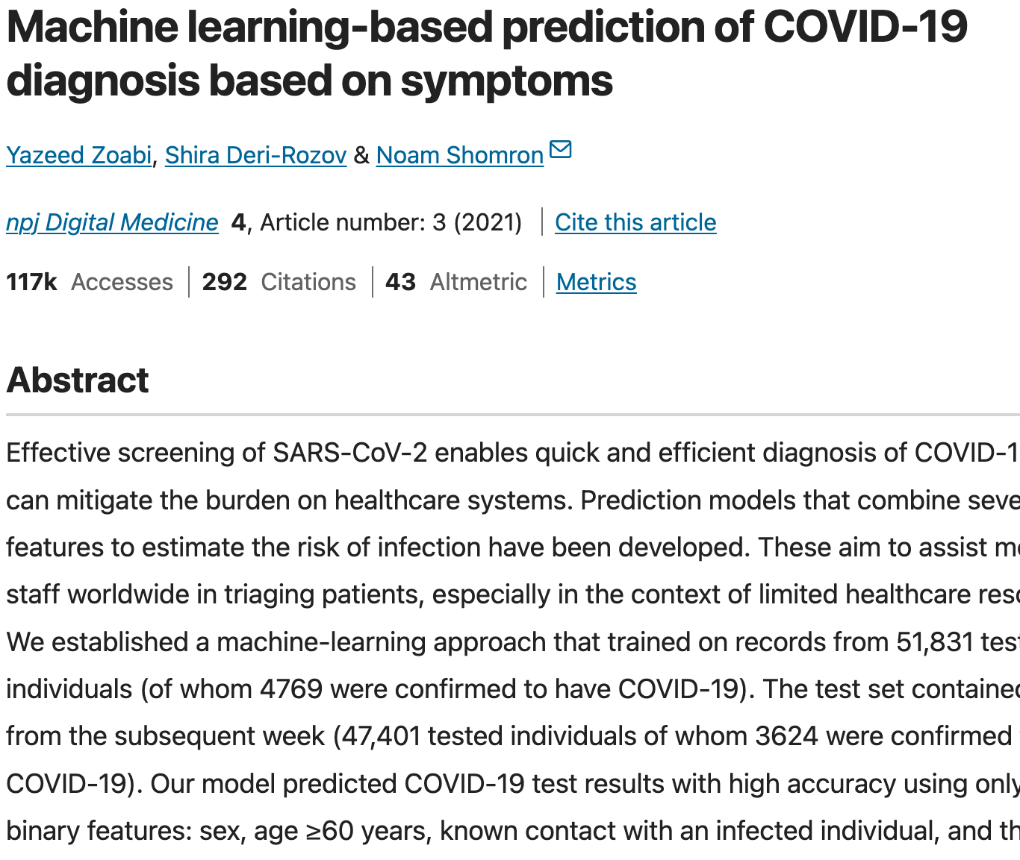
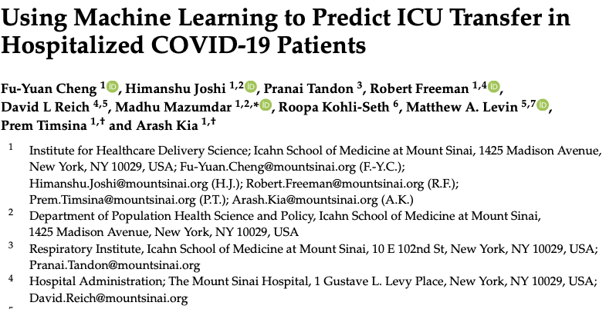
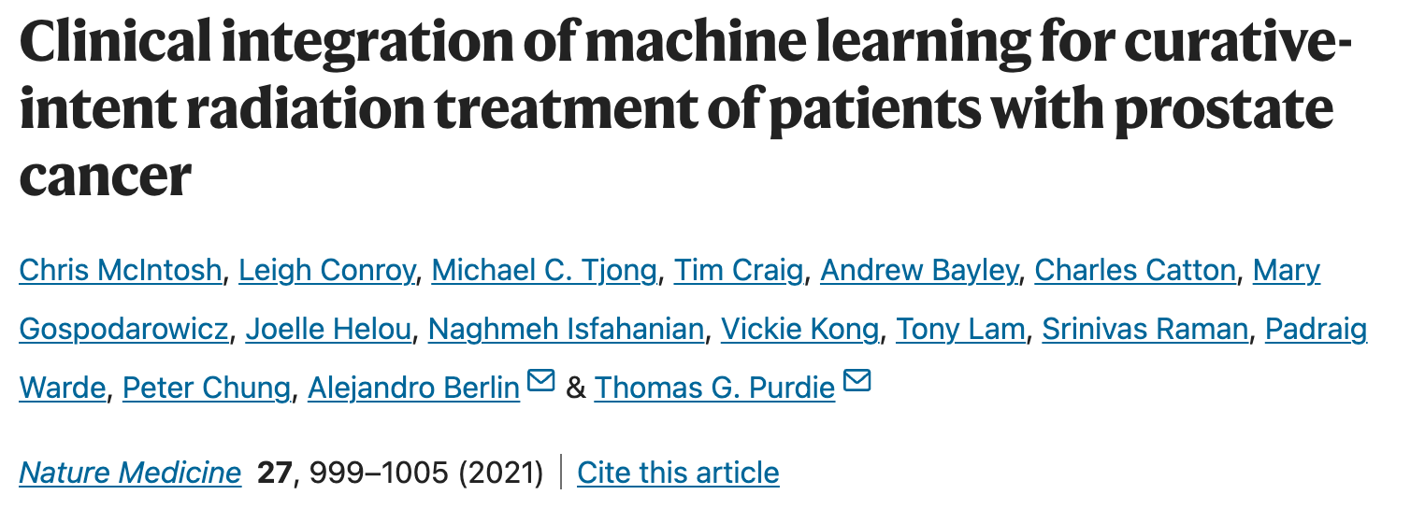
Motivations for MLT in Public Health Research
Enhance the accuracy of disease prediction and early detection
Improve the efficiency of healthcare resource allocation
Enable the development of personalized treatment plans

Slide 3

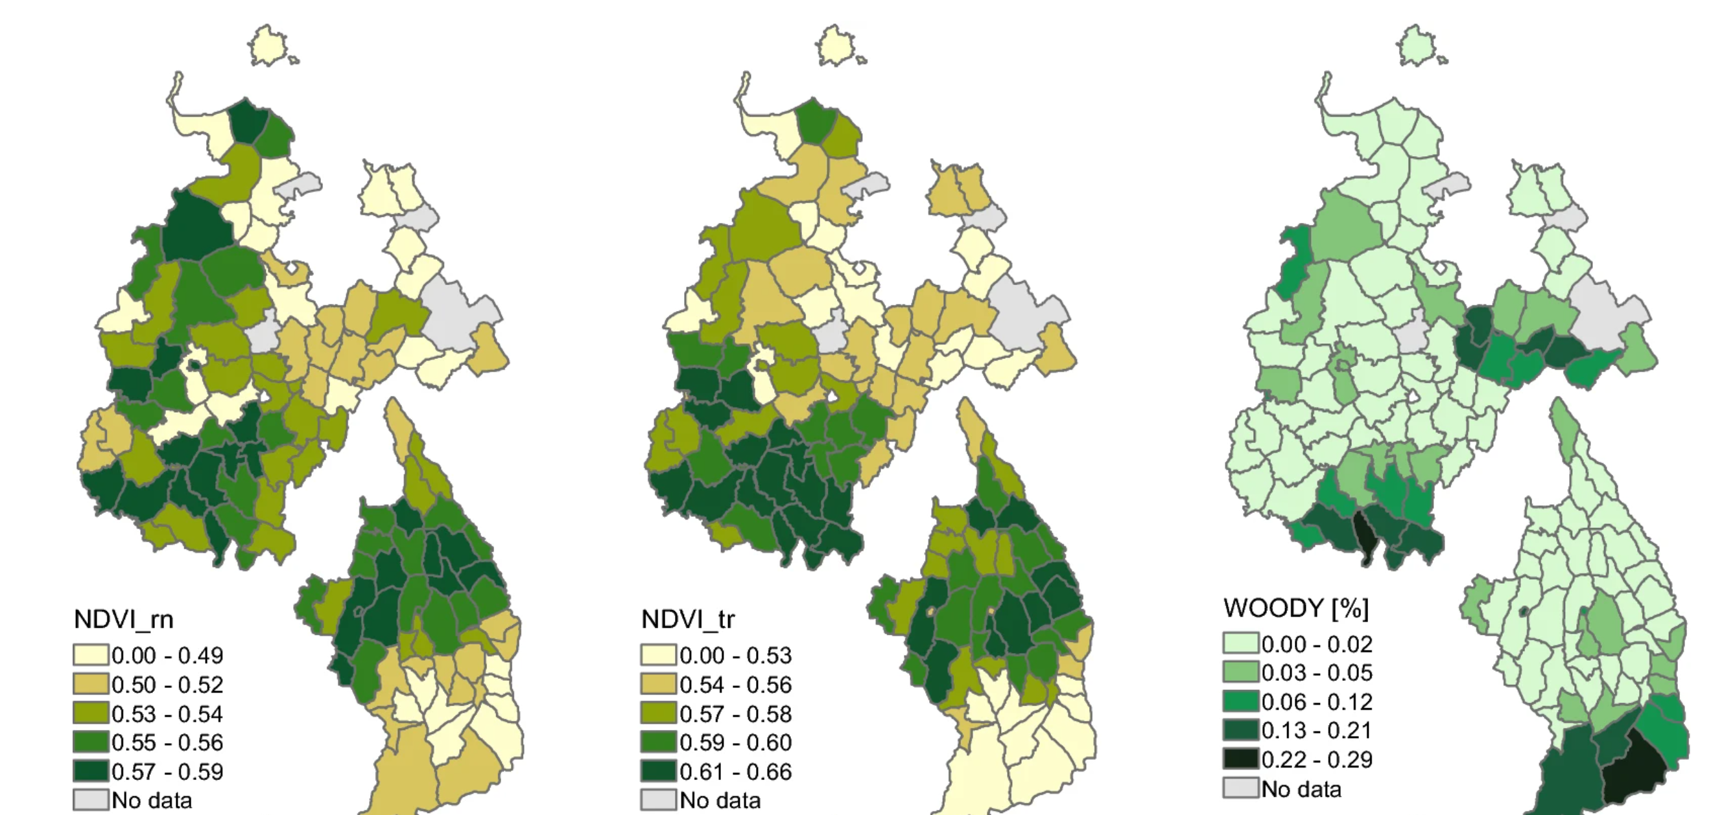
Motivations for RS in Geospatial Health Research
Facilitate the identification of social and environmental determinants of health.
Enable the mapping and real-time monitoring of disease vectors.
Provide consistent spatial and temporal coverage.

Slide 4
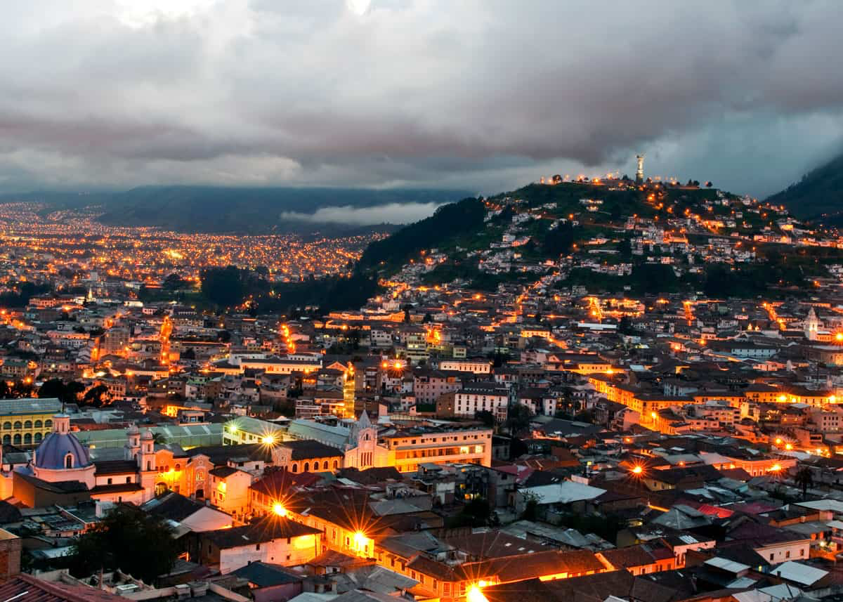
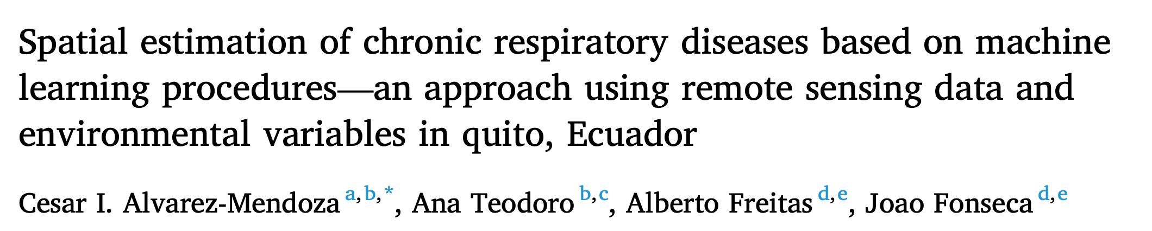
Context of Alvarez-Mendoza, et.al (2020)
STUDY
Compare the effectiveness of several machine learning models in predicting the number of hospital discharge patients with chronical respiratory diseases using remote sensing and air quality data
Understand the most significant spatial predictors and the spatial distribution of chronical respiratory disease in the city of Quito, Ecuador
GOAL

Slide 5
Context of Alvarez-Mendoza, et.al (2020)
Spatial Extent
Spatial Scale
Temporal Extent
Latitude: 0°30′S to 0°10′N
Longitude: 78°10′W to 78°40′W
The influence zones of each air quality monitoring station
2013 to 2017, grouped by trimester

Slide 6
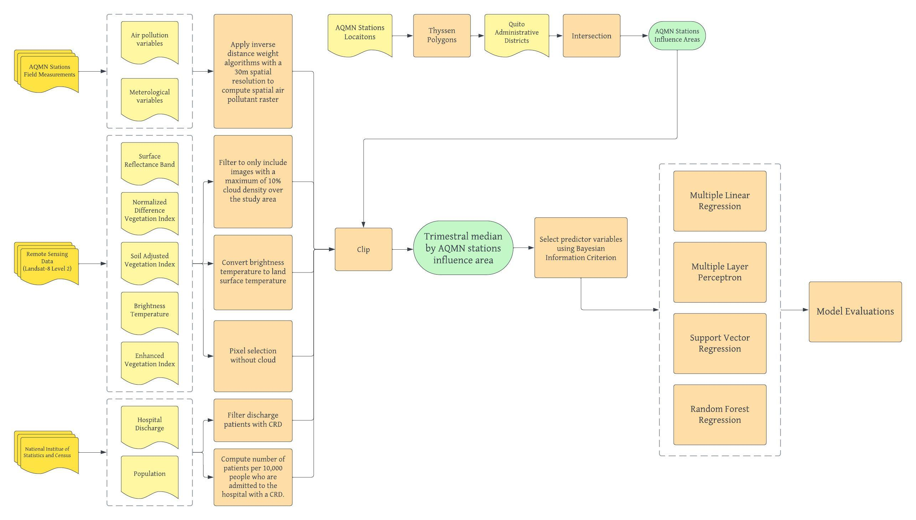
Workflow of Alvarez-Mendoza, et.al (2020)

Slide 7
Workflow of Alvarez-Mendoza, et.al (2020)
1. Dataset

Slide 8
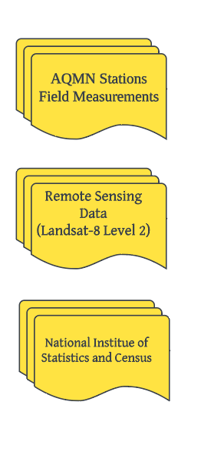
Study Data
Field Data from Quito Air Quality Monitoring Network (AQMN) that provides hourly field measurements of air pollutants and meteorological variables.
46 Landsat 8 Level 2 images between 2013 and 2017 retrieved from Land Satellite Data Systems Science Research and Development website with 30m of spatial resolution.
Hospital discharge of patients with CRD collected by the national institute statistics of census (INEC)

Slide 9
Workflow of Alvarez-Mendoza, et.al (2020)
2. Variables
3. Variable Transformation

Slide 10
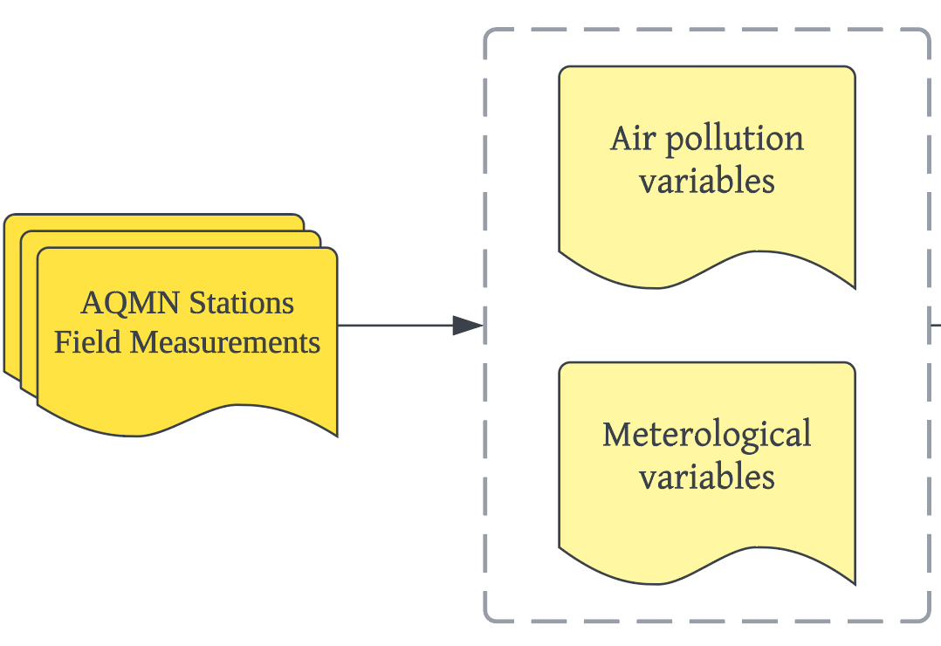
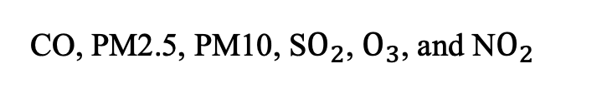
Input Variables and Transformation
CO, PM2.5, PM10, S$O_{2}$, $O_{3}$, and N$O_{2}$
pressure, wind direction, relative humidity, precipitation, wind speed, air temperature, solar irradiance

Slide 11
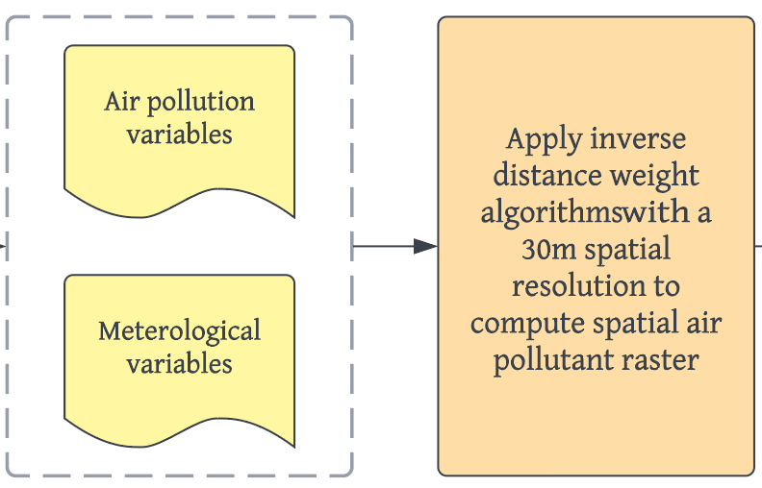
Input Variables and Transformation
IDW: uses a method of interpolation that estimates cell values by averaging the values of sample data points in the neighborhood of each processing cell.

Slide 12
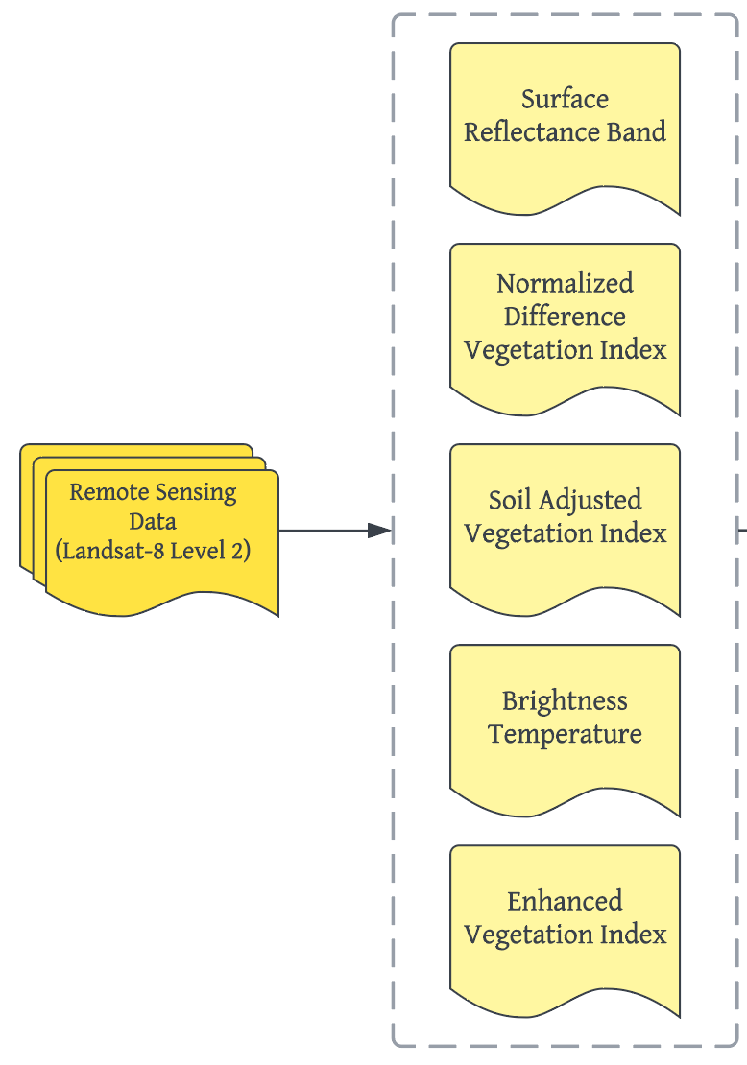
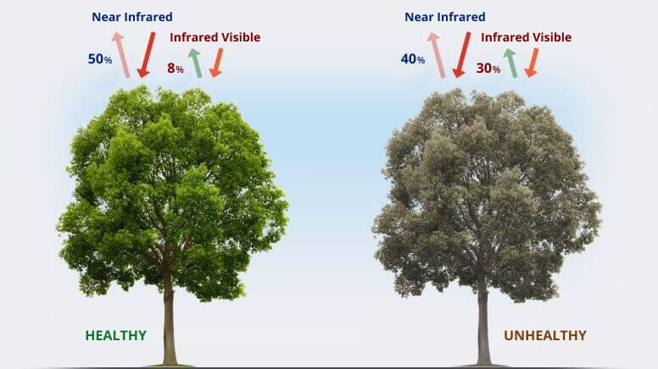
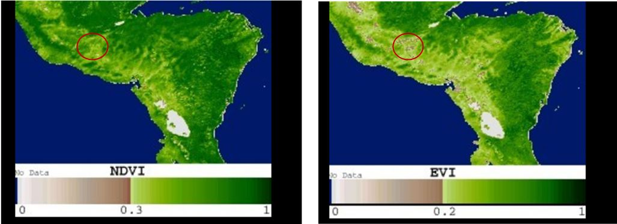
Input Variables and Transformations
Coastal aerosol band (B1), blue band (B2), green band(B3), red band (B4), near-infrared (B5), short-wave infrared 1(B6), short-wave infrared 2(B7)
Quantifying the health and density of vegetation.
NDVI = (Band 5 – Band 4) / (Band 5 + Band 4)
Correct NDVI for the influence of soil brightness in areas where vegetative cover is low
SAVI = ((Band 5 – Band 4) / (Band 5 + Band 4 + 0.5)) * (1.5)
Derived from thermal band 10, and 11.
Correct NDVI for some atmospheric conditions and canopy background noise
EVI = 2.5 * ((Band 5 – Band 4) / (Band 5 + 6 * Band 4 – 7.5 * Band 2 + 1))

Slide 13
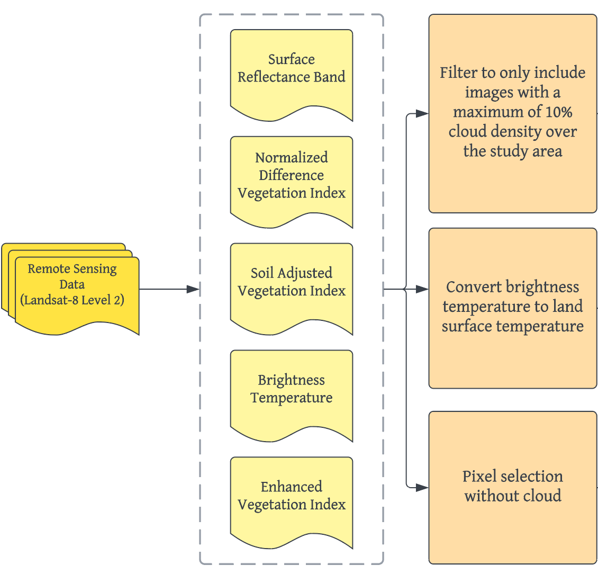
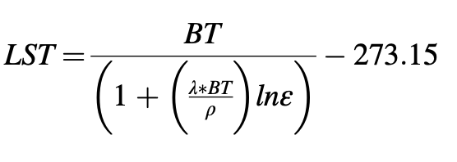
Input Variables and Transformations
Translate the brightness temperature measurements from remote sensing instruments into meaningful temperature values for the land surface.

Slide 14
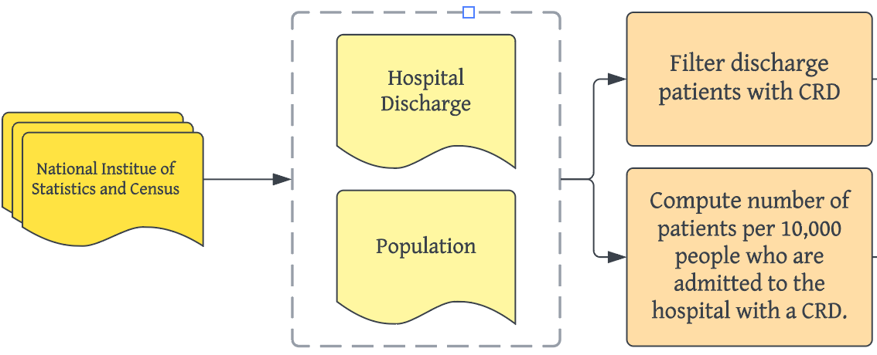
Input Variables and Transformations
For consistency and availability of matched data, group data by trimester.
Meaning that each year have 4 groups.

Slide 15
Workflow of Alvarez-Mendoza, et.al (2020)
4. Geographic Transformation

Slide 16

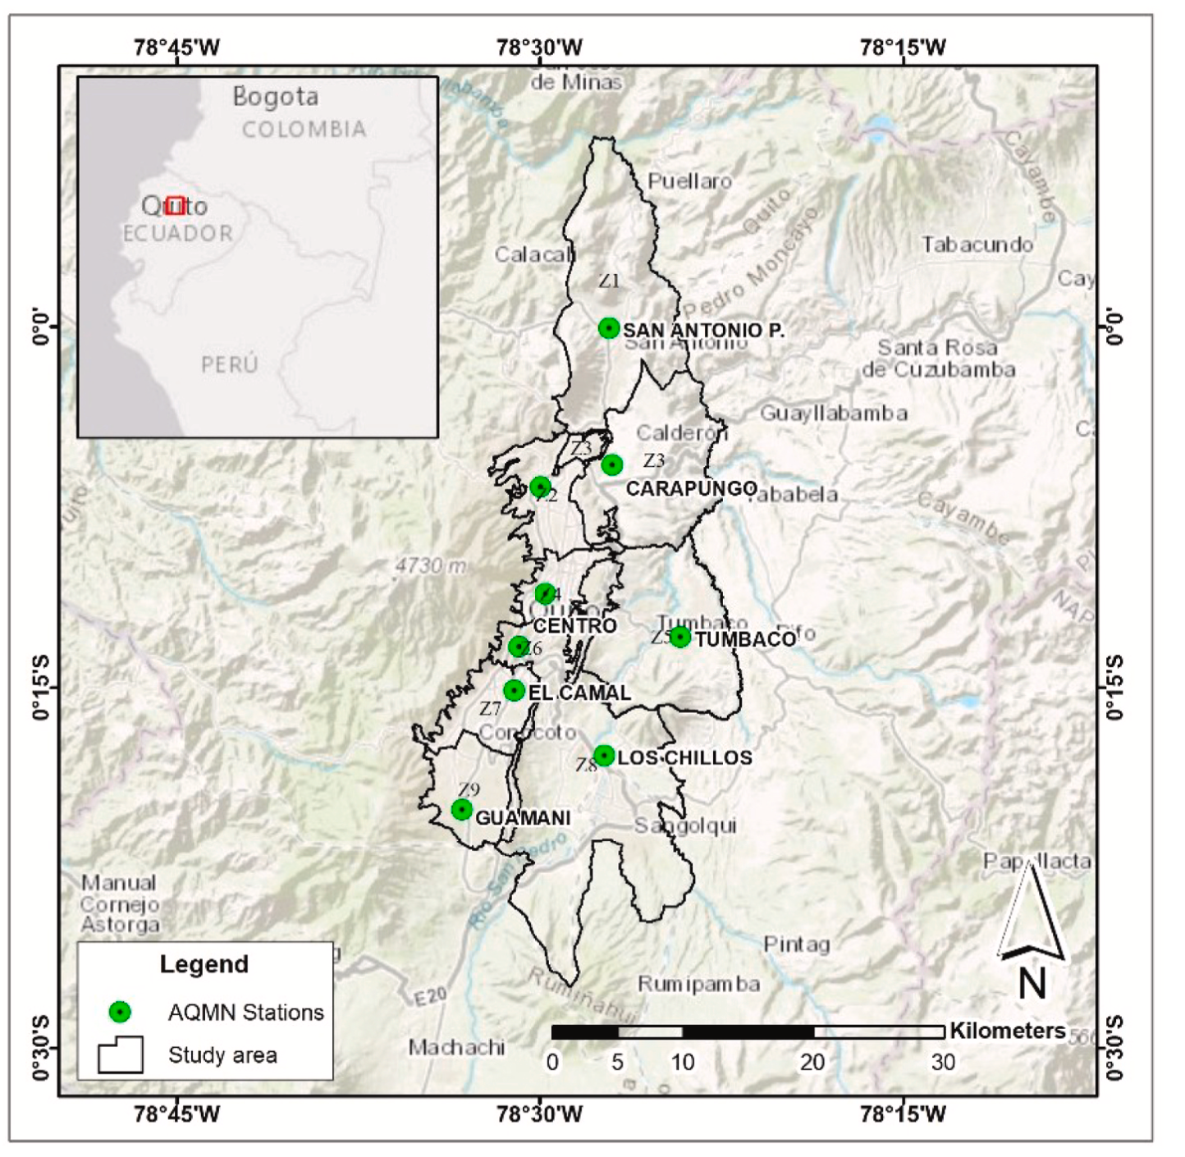
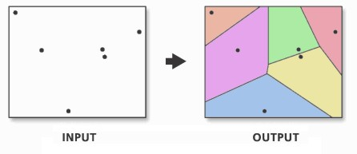
Geographic Transformations
Study Area Extent
Generate polygons from a set of sample points such that any location inside the polygon is closer to that point than any of the other sample points.
Fit polygons to the extent of study area.

Slide 17
Workflow of Alvarez-Mendoza, et.al (2020)
5. Prepare Input Dataset

Slide 18
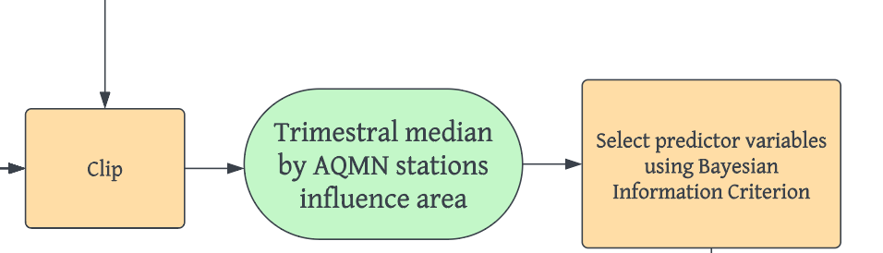
Prepare Input Dataset
AQMN Station Influence Area
Decide which statistical model is the best fit for a given set of data.
Dimensionality Reduction
Processed Data
For air quality and environmental variables, compute a mask of each AQMN area with each 30-m raster variable. The median pixel value to each AQMN area was estimated.
For hospital discharge, a summary of it in each AQMN area of influence is computed for each trimester of each year.
162 Observations (due to missing data)
24 variables
10 predictors in model

Slide 19
Workflow of Alvarez-Mendoza, et.al (2020)
6. Compute and Validate Model

Slide 20
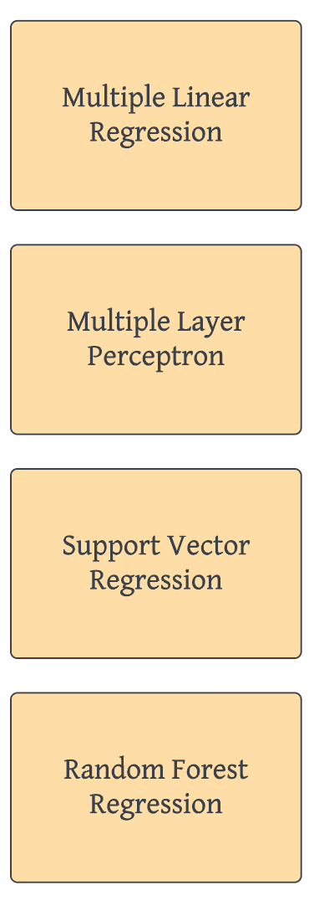
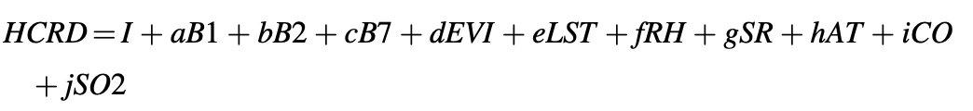
90% Training
10% Testing
10 Fold Cross Validation
Machine Learning Models

Slide 21
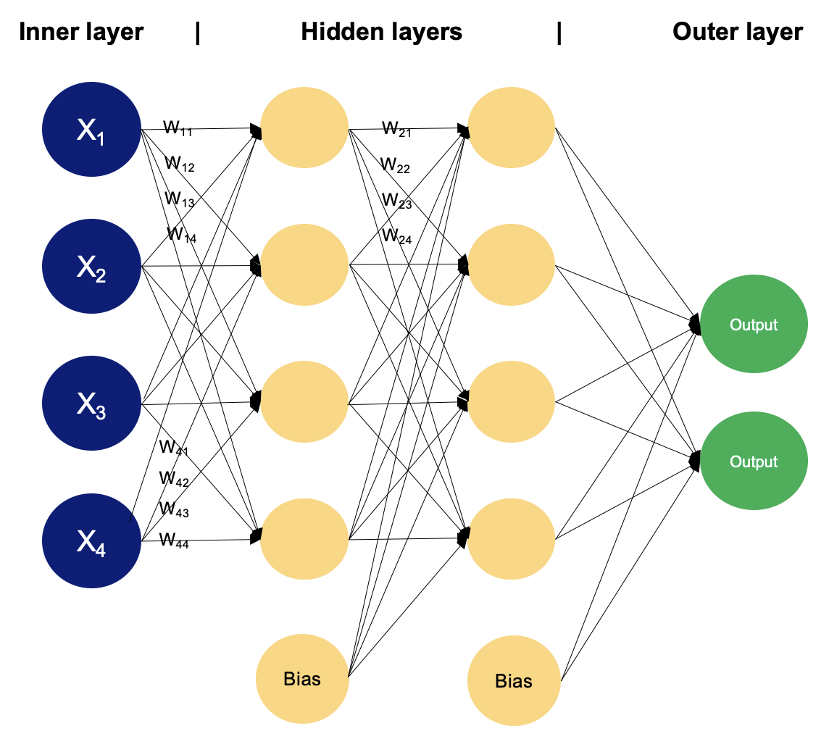
90% Training
10% Testing
10 Fold Cross Validation
Machine Learning Models
An artificial neural network model. One hidden layer and four hidden nodes was computed and evaluated.
Input Layer: each neuron here represents one feature/input variable (the brightness of one pixel in an image)
Hidden Layer: each neuron here takes inputs from all the neurons from the previous layer/input layer and calculates a weighted sum
Calculate error between predicted and actual output while weights get adjusted
Output Layer: each neuron here represent one output class

Slide 22
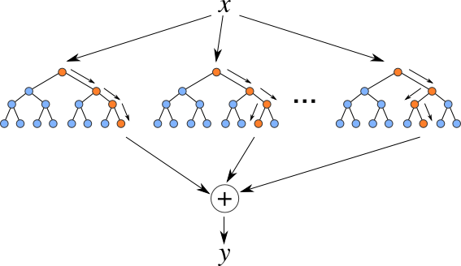
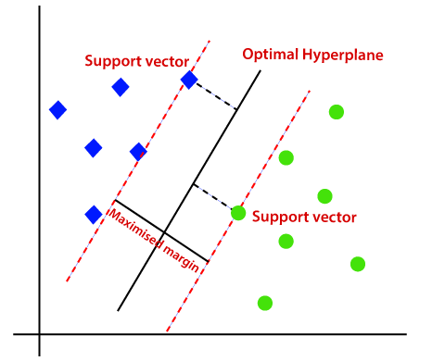
90% Training
10% Testing
10 Fold Cross Validation
Machine Learning Models
Multiple decision trees that uses best split strategy based on each attribute of the dataset.
Instead of trying to find a hyperplane that best separates classes, SVR tries to find a hyperplane that best fits the data points while still staying within a certain margin of error.

Slide 23
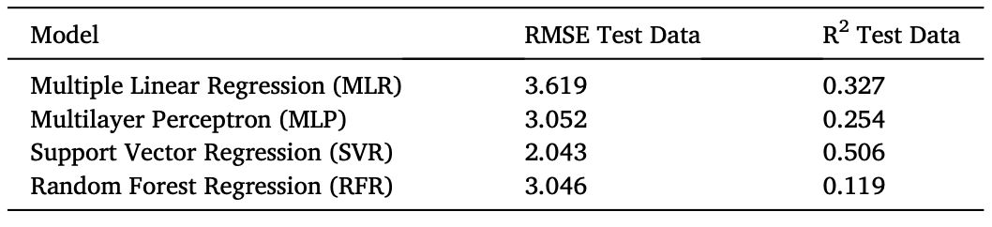
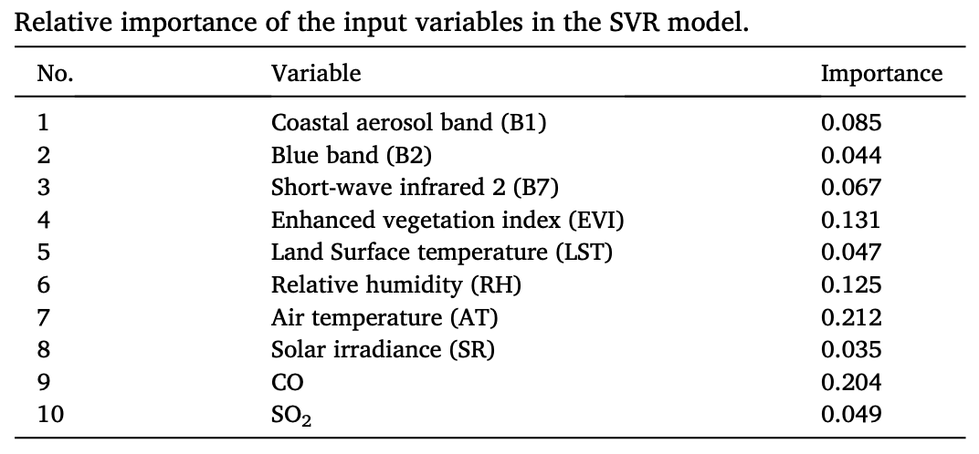
Results
The SVR model presents the lowest RMSE and the highest R2, considering the test data.
The most significant predictors were the red band, the short infra-red band, CO, and SO2. The first two are related with PM2.5 and O3, while CO and SO2 are related with air pollution.

Slide 24
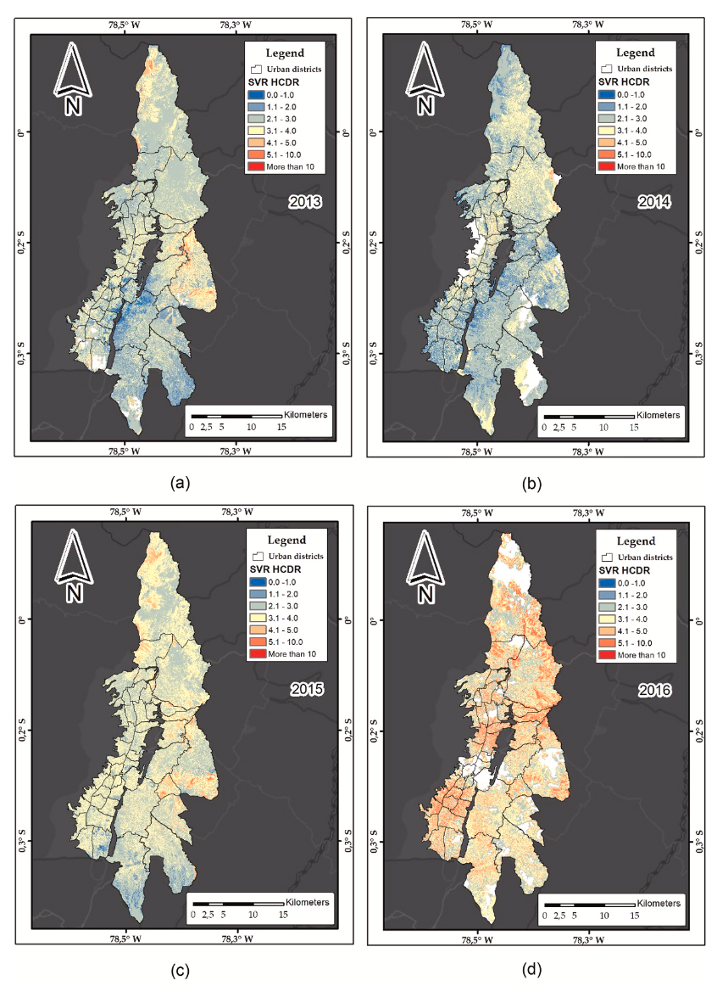
Results
There was a significant increase in reported air pollutant concentrations in the north and east region of the city between 2013 and 2017.
In the north and east regions of the city, there were higher values of HCRD, which was likely due to the fact that these areas had higher rates of air pollutants, traffic, and population.

Slide 25
Limitations
Limited number of satellite images without high cloud density.
Some air quality data and hospital discharge data are incomplete.
REPRODUCIBILITY
DATA
The percentage split of training and testing data might not be ideal.
Using PCA for dimensionality reduction before running the model.
Establish influence area that account for local geography. Create a buffer around Quito to extend the study area.
Experiment with different hyper-parameters of each machine learning models.
Include AQMN influence area, trimester, or year as variables in the model.
Enhance reproducibility by providing raw data, metadata, code, and any intermediaries.
Test this study with updated data in a different geographic area.
RESEARCH DESIGN

